Slide 1
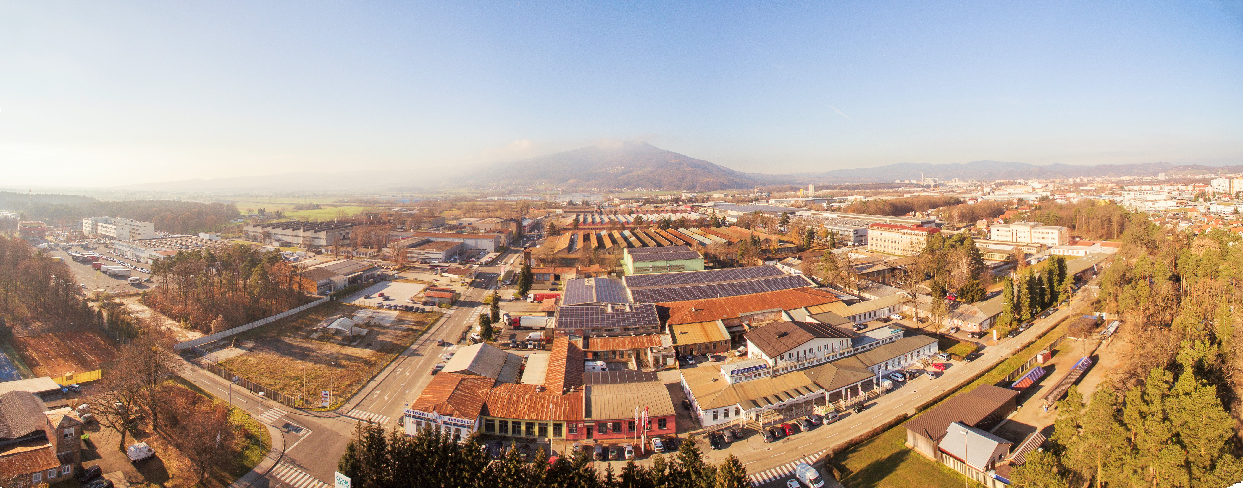
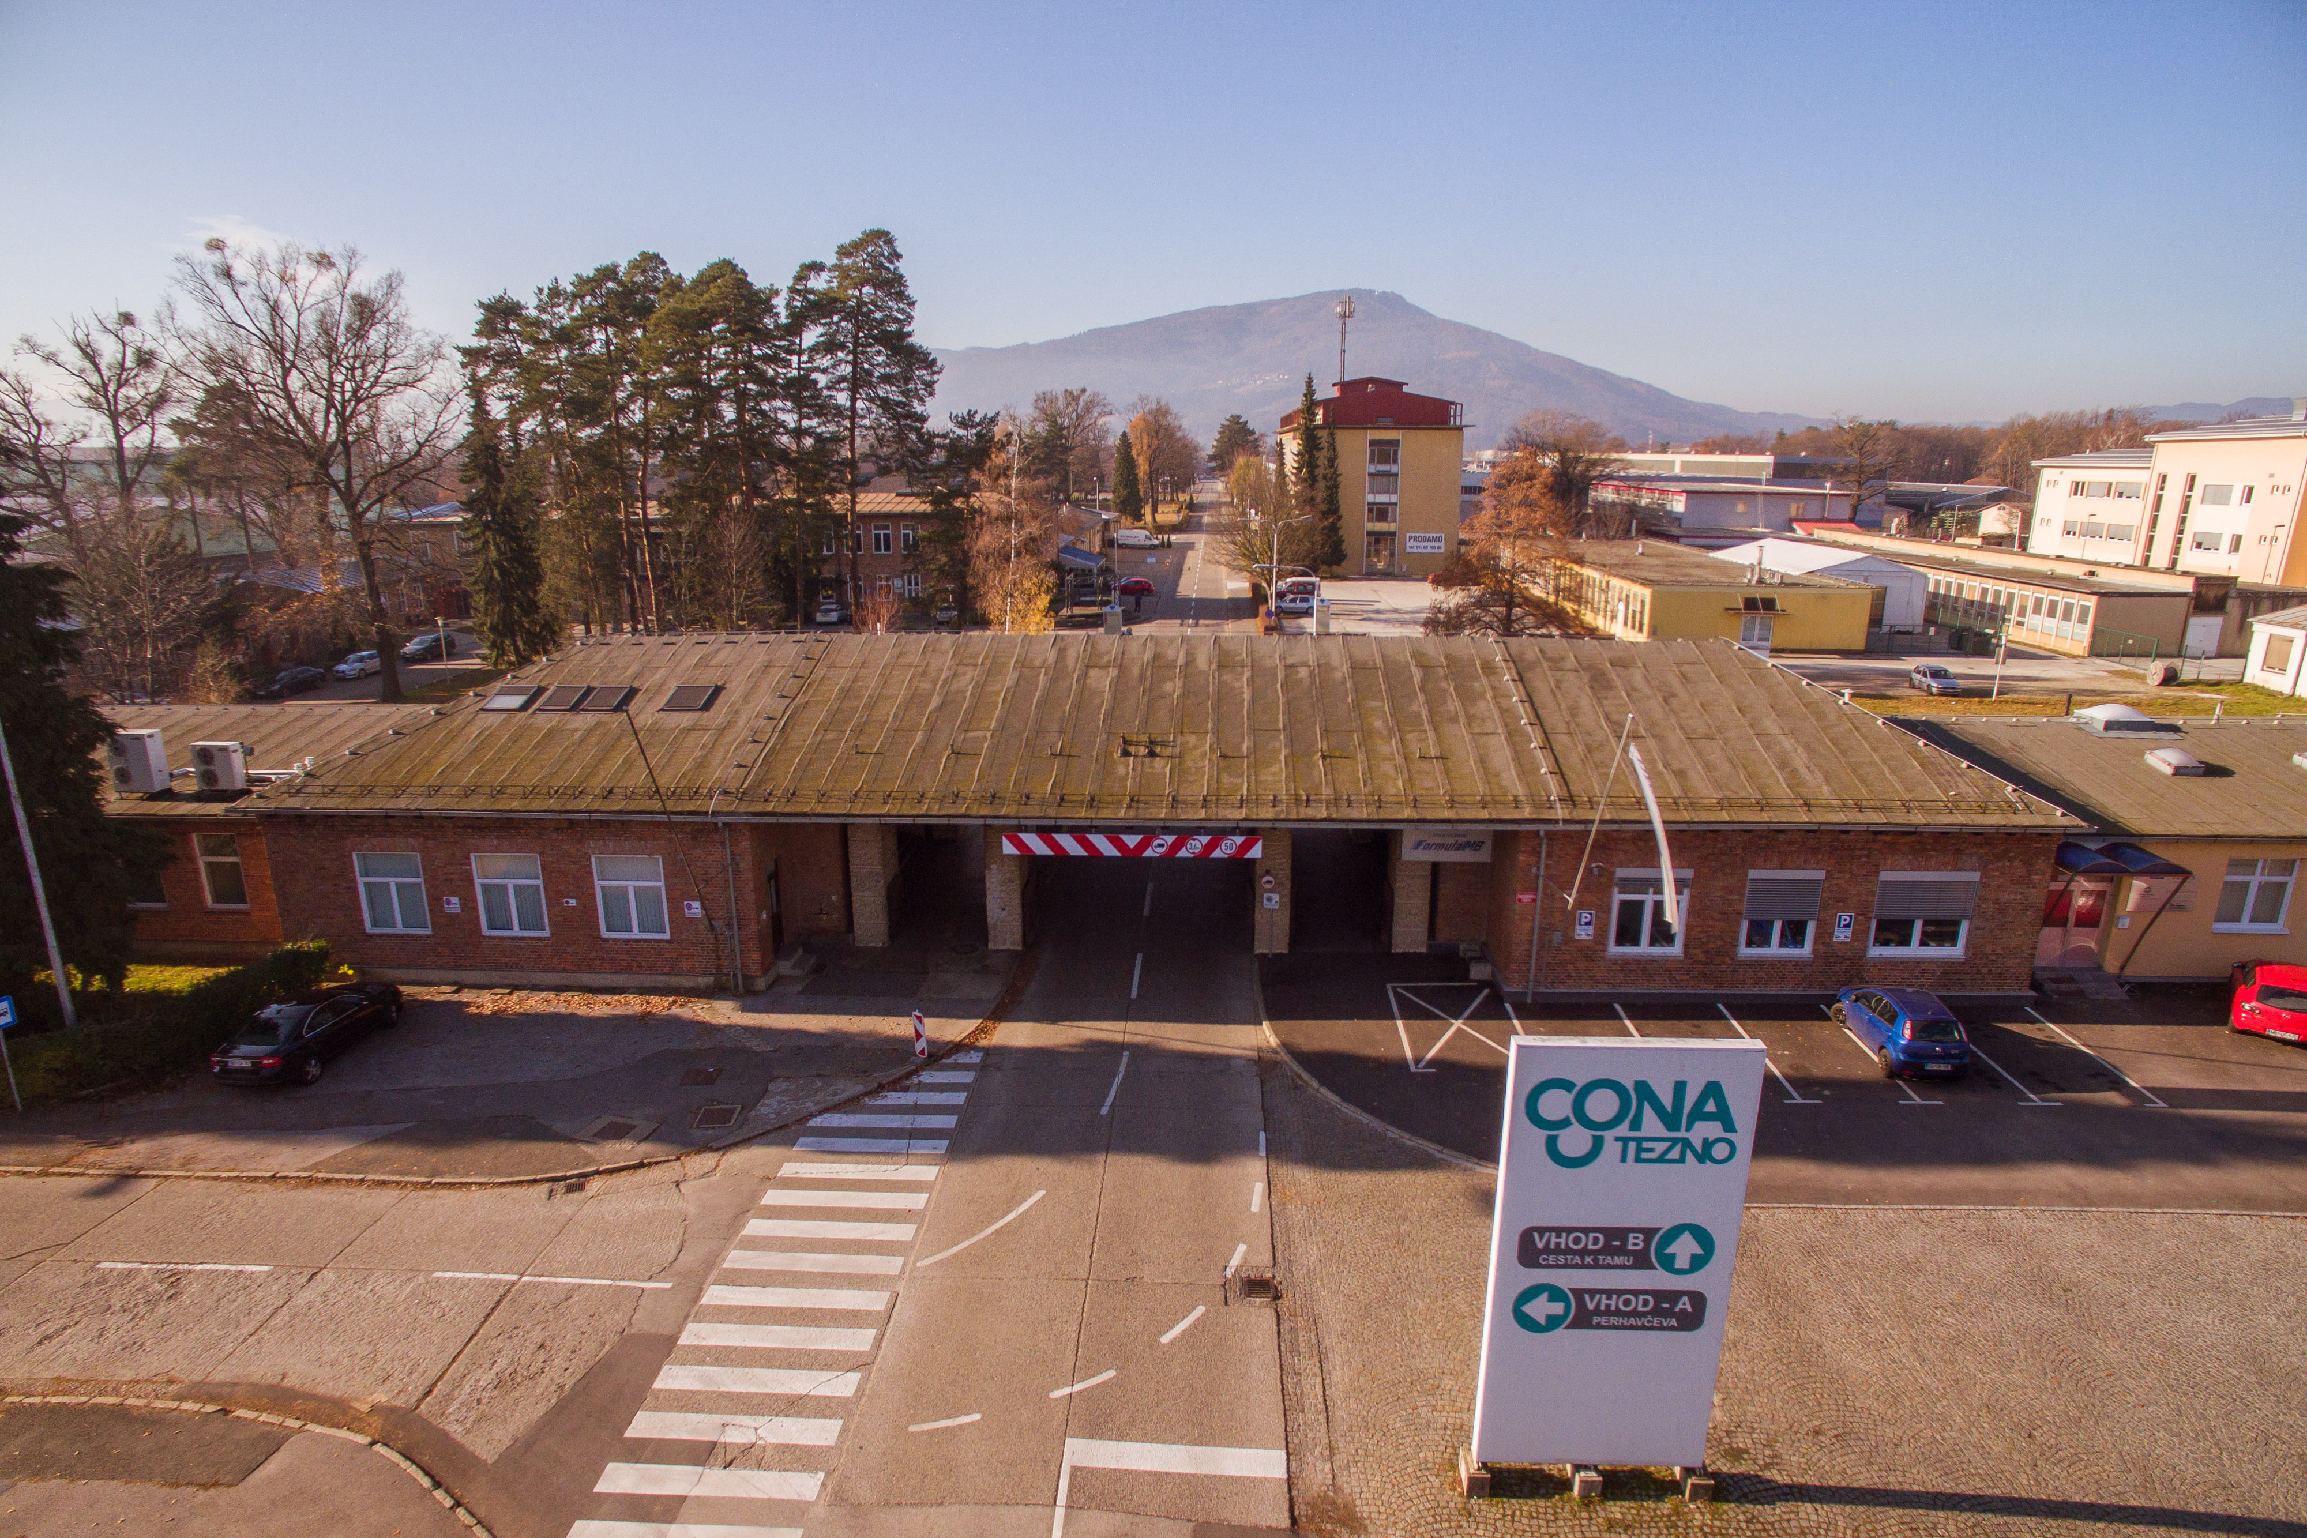

Poslovno proizvodna Cona Tezno
Tezno Business Site
Maribor

Slide 2

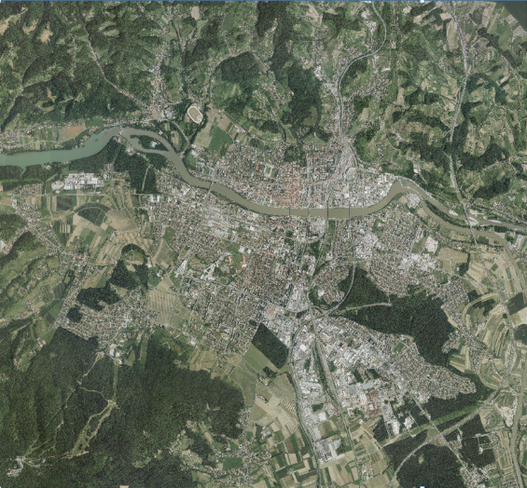

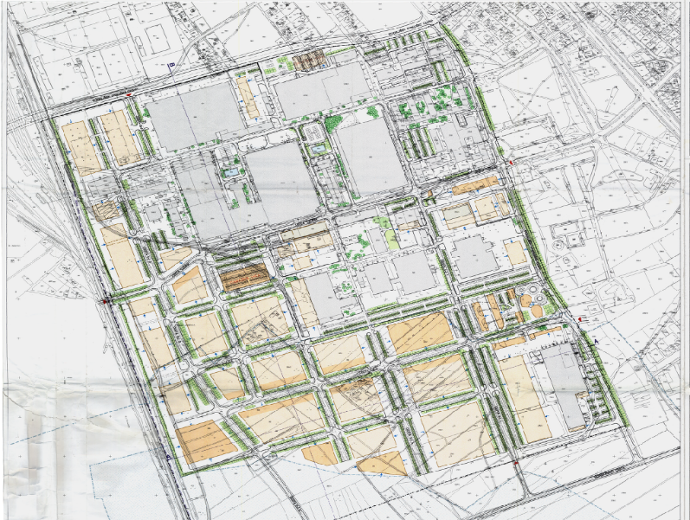
It is still enough space with us for entrepreneurial initiatives!
108 hectares of building land
A-Site: 60 hectares, B-Site: 48 hectares
193 companies, 3602 jobs

Slide 3
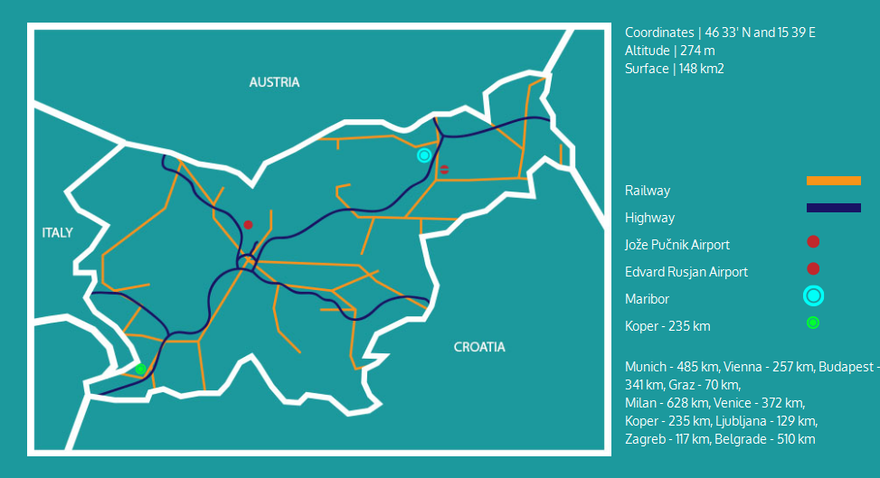
Excellent location and accessibility

Slide 4
Sectors of activity
Legend: C – Manufacturing; F – Construction; G – Wholesale and retail trade; repair of motor vehicles and motorcycles;
H – Transportation and storage; J – Information and communication; M – Professional, scientific and technical activities;
P – Education ; Other: Energy & water supply, Financial and insurance activities, Hospitality services, Health and sports activities …

Slide 5
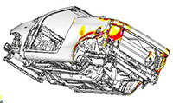
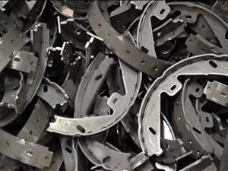
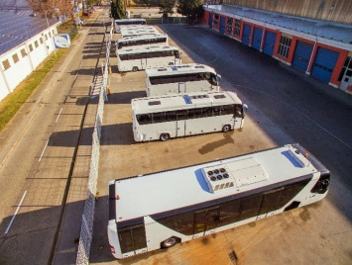
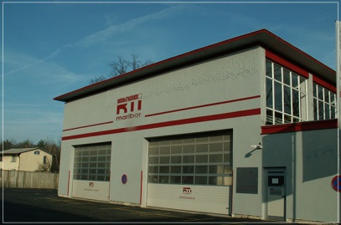
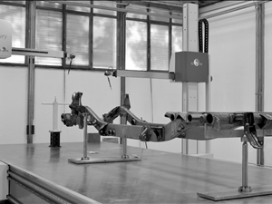
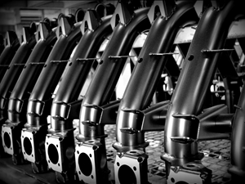
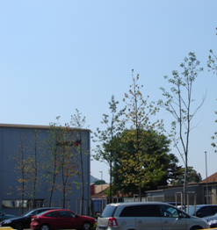
RD-oriented companies in international value chains
DEVELOPMENT & PRODUCTION OF PARTS AND COMPONENTS FOR AUTOMOTIVE INDUSTRY
Production of engine parts, chassis, bodies, engines and steering mechanisms for global automotive producers, from castings made of grey cast iron and
aluminium to final machining (CIMOS, STARKOM, BNM)
Bus manufacturing (TAM - EUROPE)
Development, design and prototyping of vehicles, components and
equipment for electric and hybrid vehicles (RTC, PIKTRONIK)
Development of tools for automotive industry (IMENŠEK Toolshop)
Inspection, testing and certification of vehicles of all categories (RTI)

Slide 6
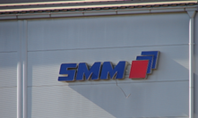
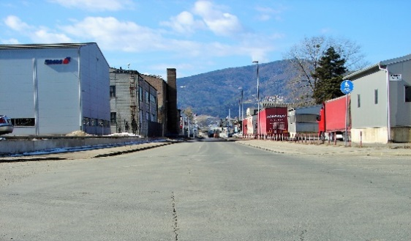
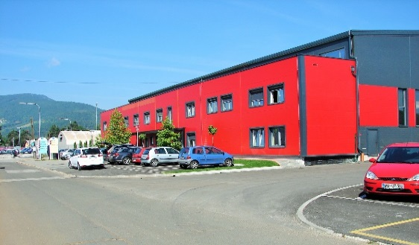
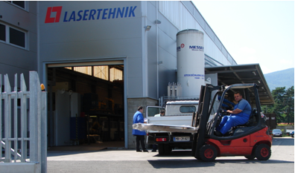
RD-oriented companies in international value chains
AUTOMATION, MACHINE BUILDING, METAL WORK WITH MODERN TECHNOLOGIES
Development, engineering, machinery, automation, management and control of complex production systems (SMM)
Design and production of steel structures, machinery,
metalworks of devices and tools, laser-technology metal
processing (LASERTEHNIK MARFIN, FORTIS, STAMLE)

Slide 7
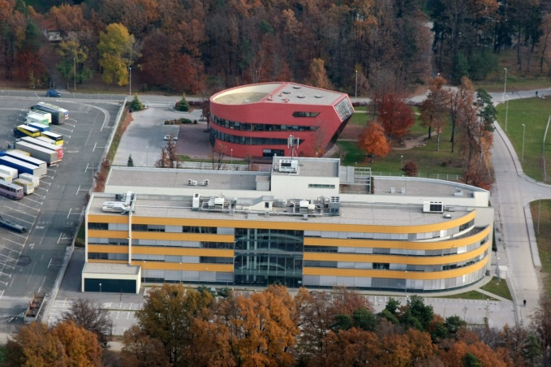
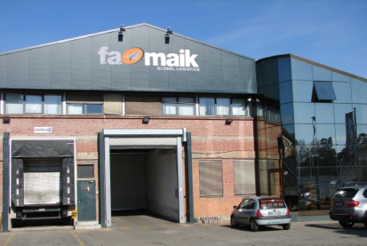
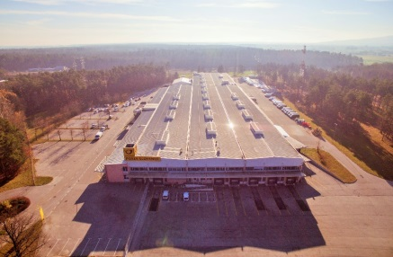
Accompanying and support activities
ICT, business inteligence, management consulting:
Software development and IT solutions for high-tech producers, custom application development, e-solutions, IT service and monitoring tool management, business intelligence, and management consulting (ARHIDES, COMTRADE, MENERGA)
Complex logistics and transport solutions:
International transport by road, rail, air, sea and inland waterways, international licenses, handling, storage, commissioning, labeling, repackaging, etc. (F.A. MAIK, A.B.T, POŠTA SLOVENIJE Logistic Centre)
Complete construction services – for companies planning to build in the Site:
From consulting and technical assistance, design, construction of facilities and devices, to control systems (BRUS Asphaltworks, TRGOGRAD)
Financial, business services, healthcare, sports, etc.:
Marketing services, design and production of promotional materials (VERUS, HIŠA IDEJ)
Healthcare and sports services (Adolf Drolc HC, BARADA Sports Centre, NATKA Tennis Club)

Slide 8
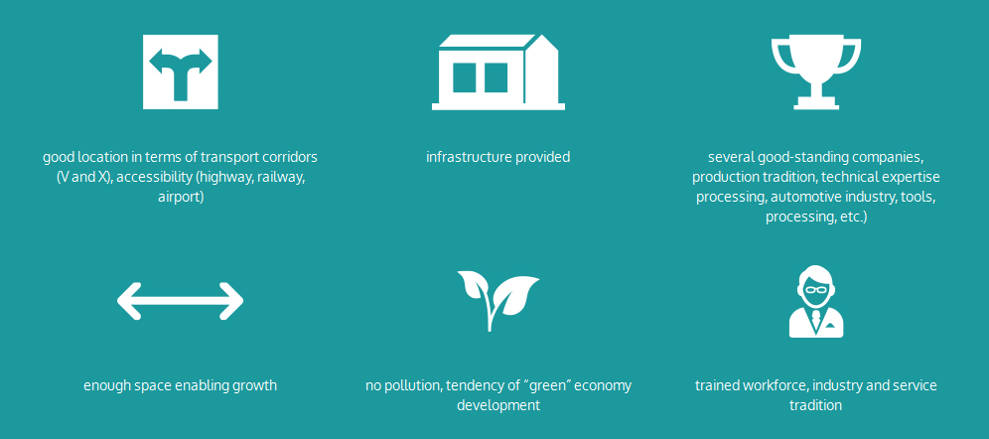
Cona Tezno provides companies with everything they need …

Slide 9
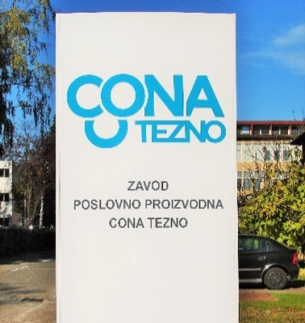
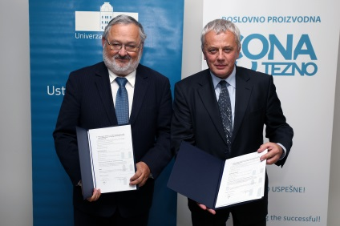
Zavod poslovno proizvodna Cona Tezno – PPC Tezno Institution
Cona Tezno is an informal community of enterprises. PPC Tezno Institution was founded by the first buyers in order to manage the common infrastructure. The Institution is responsible for:
Promoting and harmonising business interests of companies operating in the Site with interests of the local and broader environment
Developing a comparable competitive environment for companies operating in the Site, and those that plan to move to the Site
Promoting the Site and its companies in national and international environment, and networking
Networking with educational and R&D organisations in the area
Managing the Site and supplying energy at competitive prices
Maintaining the common infrastructure (roads, utility infrastructure and devices, energy and ICT)
„Greening “ the Site: electric bicycles, electric car charging stations, energy-saving lamps, solar power plants …

Slide 10
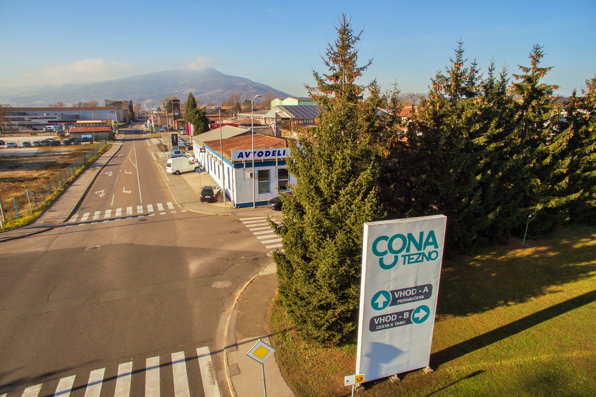
Vision
EXCELLENT INTERNATIONALLY COMPETITIVE SITE FOR SUCCESSFUL COMPANIES

Slide 11
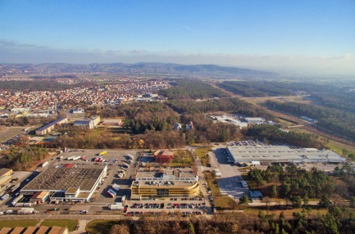
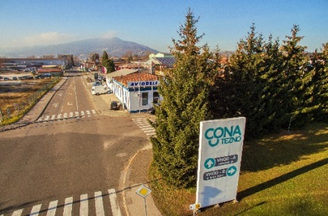
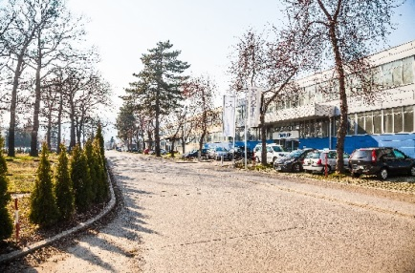
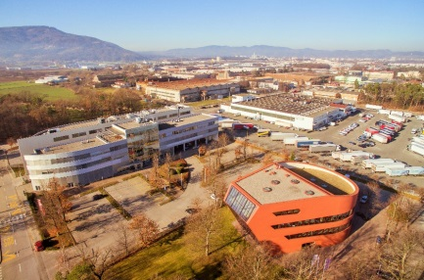
Road and utility infrastructure construction in 48 hectares of land …
MID-TERM GOAL: activating publicly-owned land for:
  50-100 enterprises
  approx. 2000 new jobs
PRE-REQUISITE:
  Demand for locations: IS PRESENT AND GROWING
Road and utility infrastructure construction in B Site (48 hectares)
Connecting Cona Tezno to the south access road Ljubljana-Maribor (rail underpass in the western part of the Site)
Modernisation of utility infrastructure and roads in A Site (over 70 years old infrastructure)
Construction of a technology park in cooperation with the University of Maribor (UM), and provision of R&D services by UM to companies
Construction of office-production & warehouse premises for rental in order to accelerate location of incoming companies in the Site (private-public partnership)
Provision of internationally competitive conditions to attract incoming companies: land prices, time to obtain building permits, support services in cooperation with national and local authorities.

Slide 12
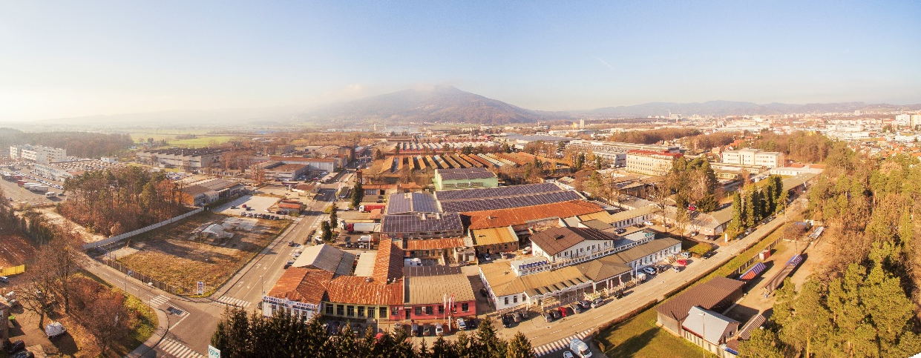
… And comprehensive business support for incoming companies
Assistance with seeking business partners in the Site
Establishing contacts with development institutions and organisations, and assistance with accessing funds for development
Expert advice and assistance with locating companies in the Site
Assistance with land purchase and constructing office premises and production plants
Business and technology consulting and mentoring
Advice and professional assistance with business plans, investment proposals, etc.
Assistance with looking for adequate human resources, education & training, and recruiting.

Slide 13
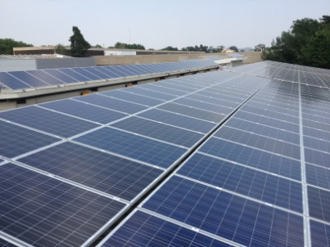
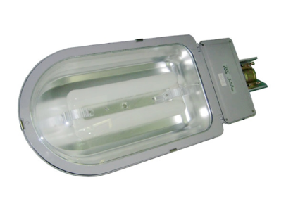
EE – Energy efficiency and RES – Renewable energy sources
… The aim is to increase energy supply security, to reduce energy costs in ZPPCT‘s final customers, and to increase the competitiveness of the Slovenian economy …
Energetska agencija za Podravje
European Mobility Week, September 2014
- Involve – EU-funded project
- 4 charging stations, 2 electric bicycles
4 solar power plants
Replaced lighting bodies

Slide 14
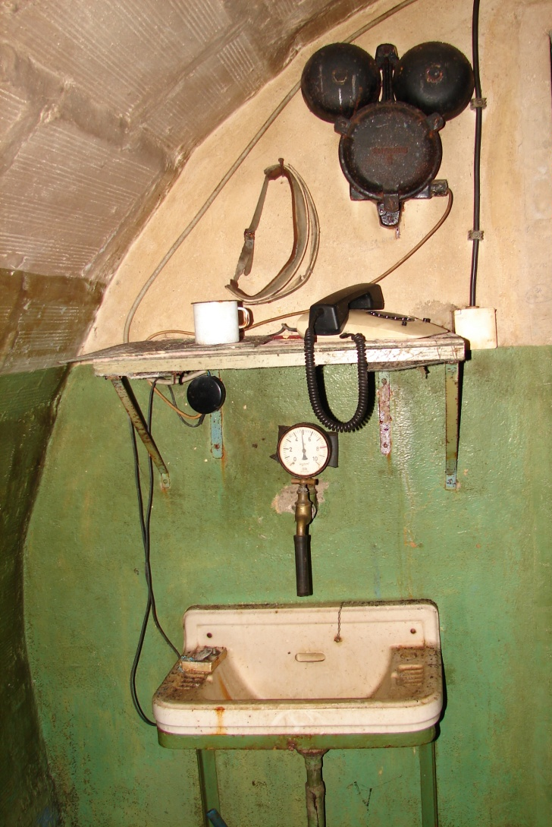
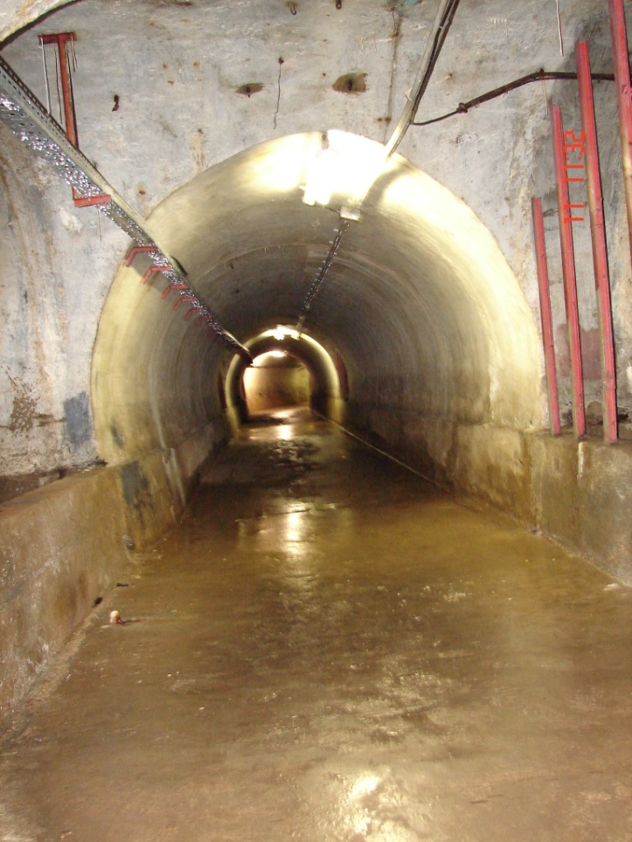
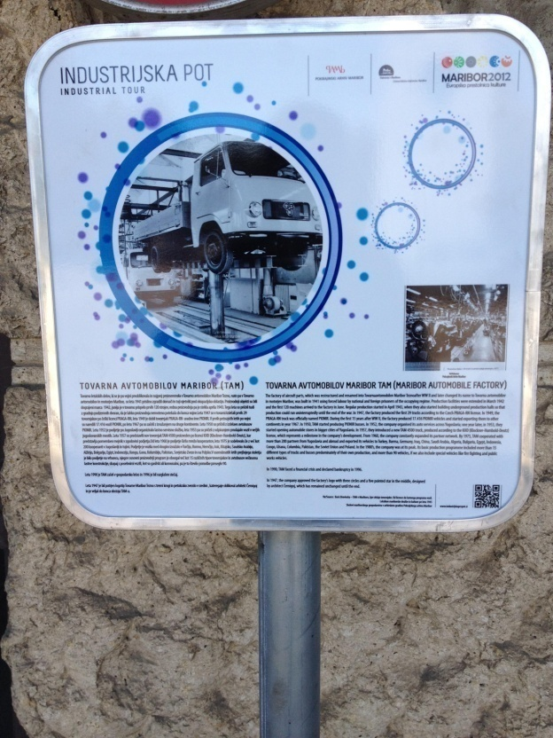
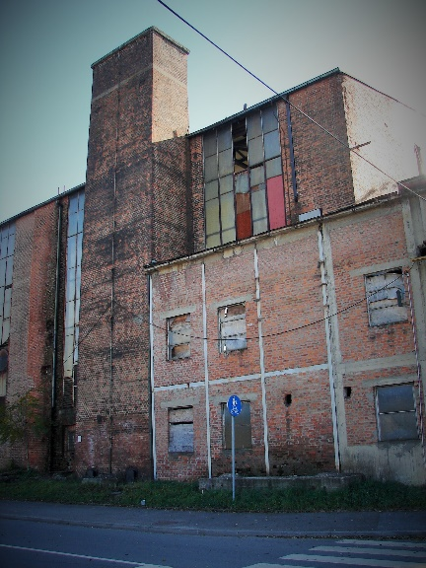
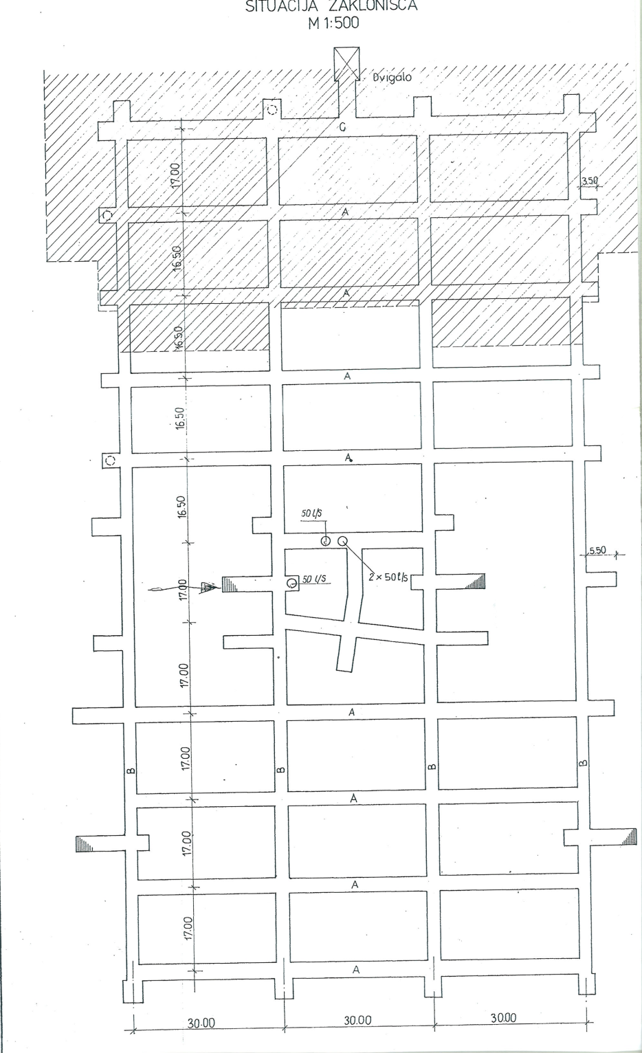
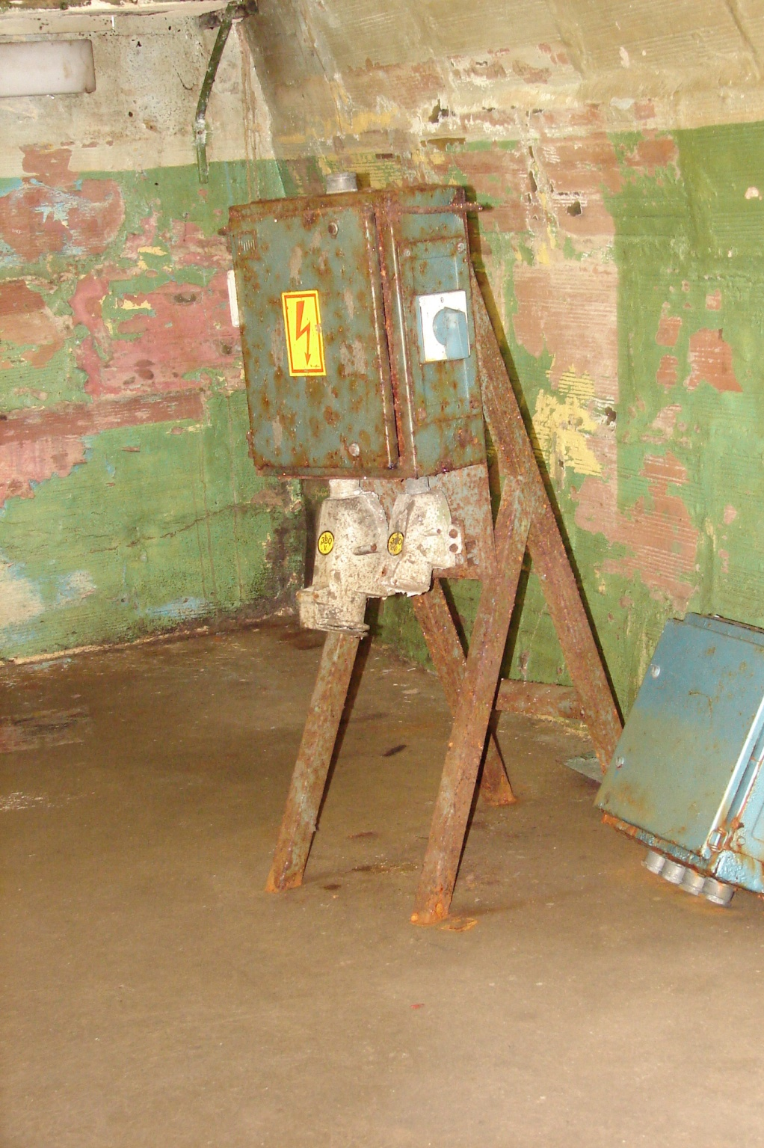
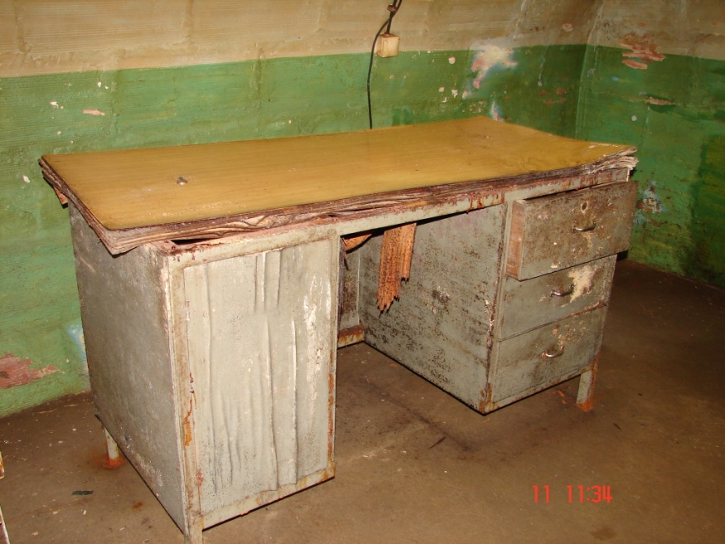
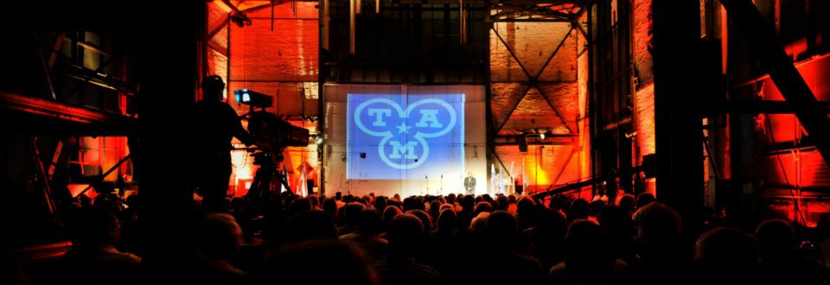
Industrial heritage is a tourist attraction
Underground tunnels built
in 1943
Area of 8,512 m²
Depth of 15 m
3.5 km of network preserved
1 entrance
Origins of the factory date back to the time of World War II, when the Germans needed a safe and suitable location for aircraft parts manufacturing. Construction works began on 25 July 1941.
After the war, the Federal Ministry of Industry decided to switch the company from the aircraft production into automotive industry. As at 31 December 1946, the Government of Yugoslavia adopted a document renaming the factory of aircraft parts into Tovarna avtomobilov Maribor Tezno - TAM. TAM eventually became the largest truck and bus producer in Yugoslavia. In 1961, the factory was renamed into Tovarno avtomobilov in motorjev Maribor. In 1986, the 200,000th vehicle was produced in TAM, and the factory employed 8175 employees.

Slide 15
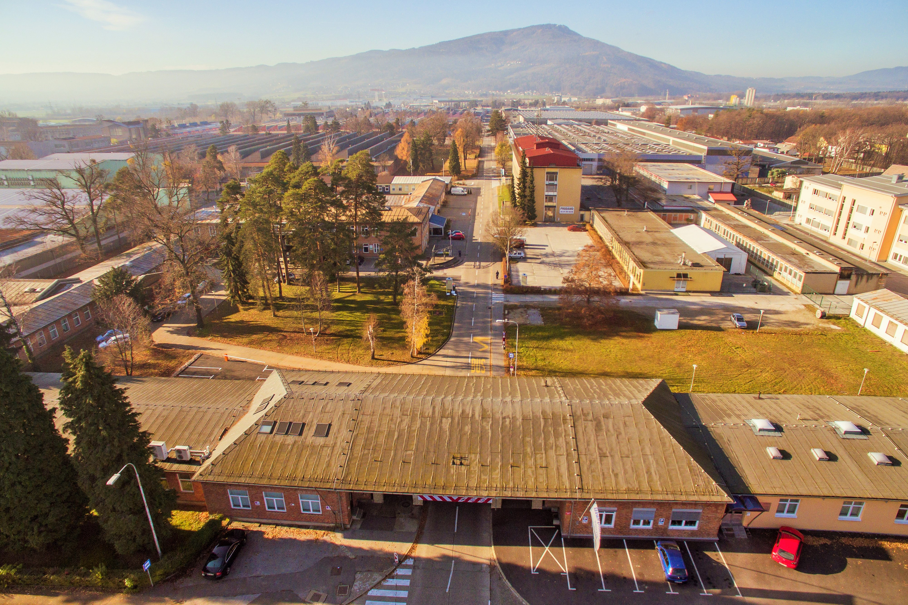

Zavod Poslovno proizvodna Cona Tezno
Cesta k Tamu 27, Maribor
Phone: +386 (0)2 46 01 300
E-mail: info@conatezno.si
Website: www.conatezno.si
THANK YOU FOR YOUR ATTENTION!

