Slide 1
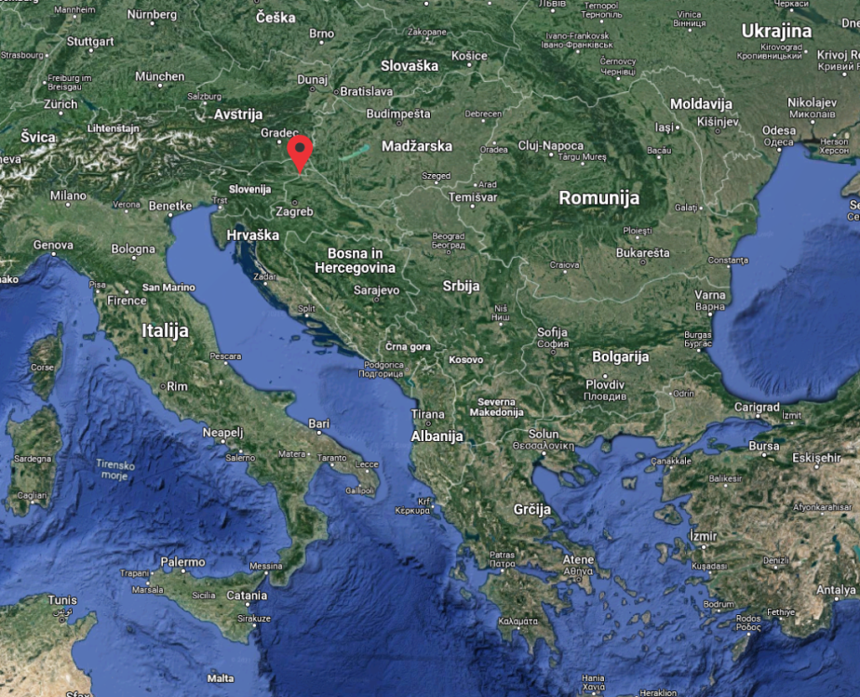
LOGISTIC - BUSINESS - PRODUCTION
FACILITY ORMOŽ

Slide 2
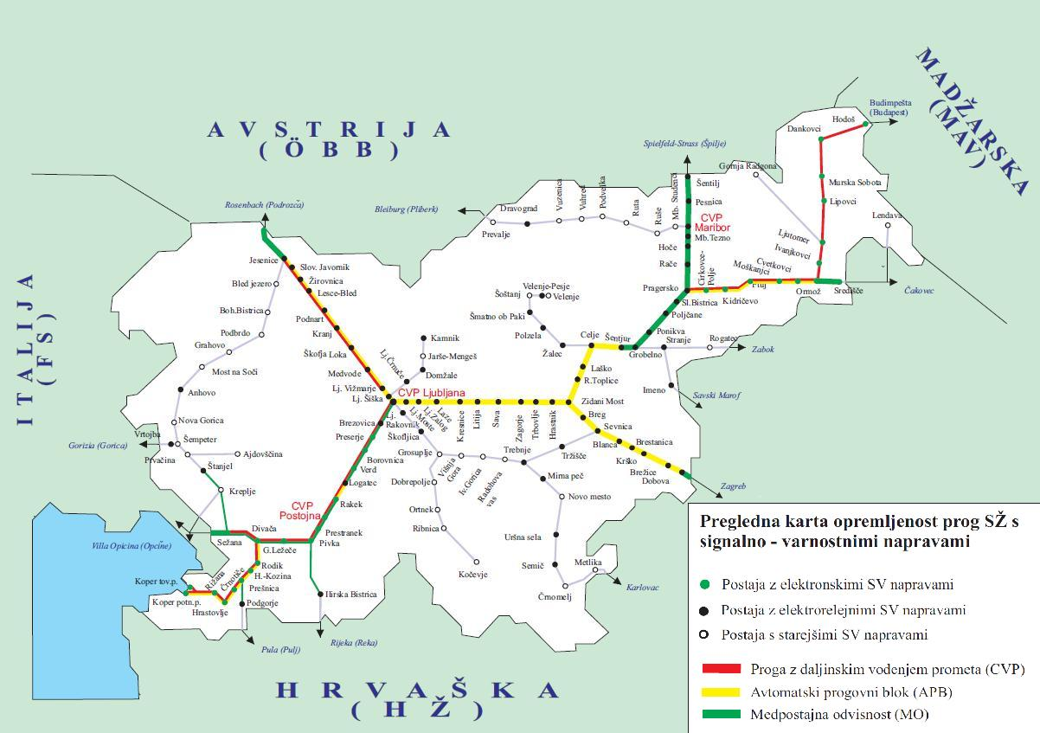
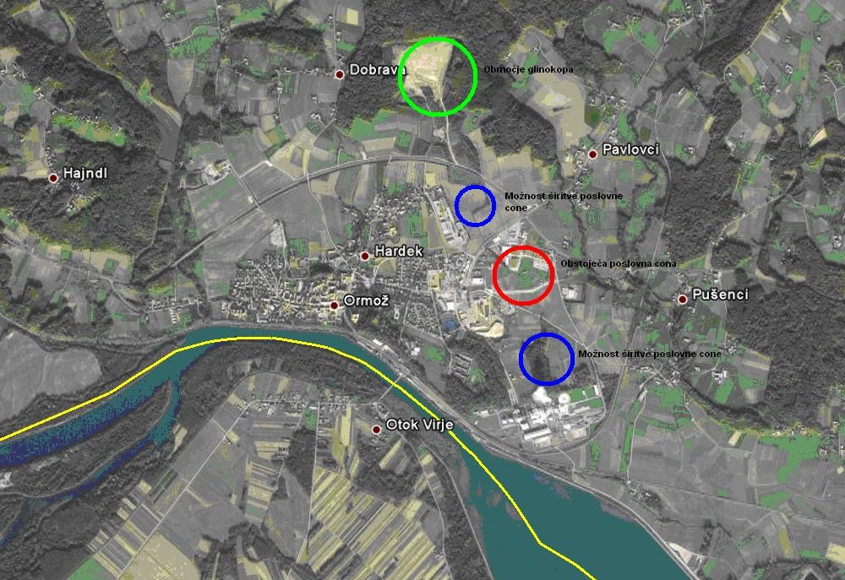
Railway lines cross Slovenia
Micro location

Slide 3
Characteristics of the utility existing equipment
Available surface: 22,5 ha
Two access roads
Connections to water resources
  Drinking water from the city water network
  Water from own wells 4 x 30m3/h – powering boilers
  Water from the reservoir lake of the river Drava – hydrant network

Slide 4
Connection to the gas network
  Dimension of the inlet pipeline: Ǿ = 200mm
  Inlet pressure (40) / 4 bar
  Capacity of 10.000 Nm3/h of natural gas
  Distribution by location
Connection to the electrical network
  Voltage at the 20 kV supply
  Connection power max. 8 MW
  Two power supply cables (2MW and 6 MW)

Slide 5
Connection to the telephone network
2 road connections
Rail tracks
  Five industrial rail tracks with interconnections (switches) throughout the entire area in the direction from West to East in total length of 3km.
  Direct connection with the railway station Ormož and the Koper-Ljubljana-Ormož-Murska Sobota-Budapest route, or from Ormož further towards Čakovec, Zagreb or Beograd.
Scales
  Road 3 x 60 t (6 bridges)
  Railway 1 x 100 t (2 bridges)

Slide 6
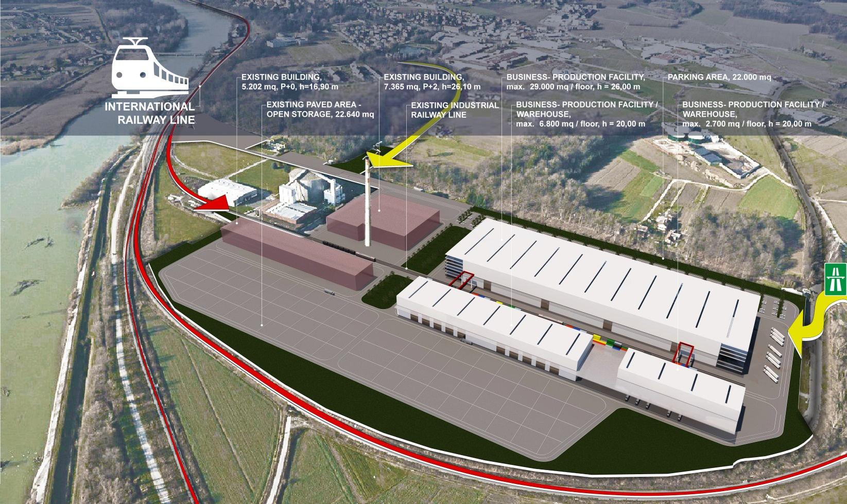
Logistic – Business - Production facility

Slide 7
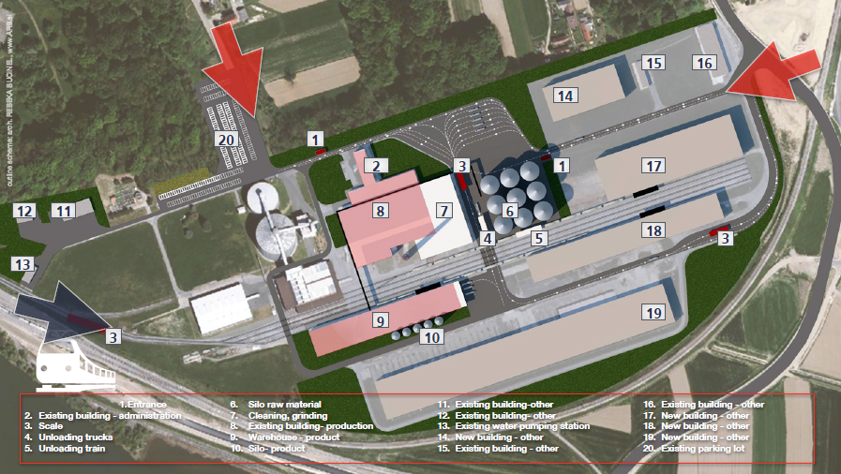
Starch factory

Slide 8
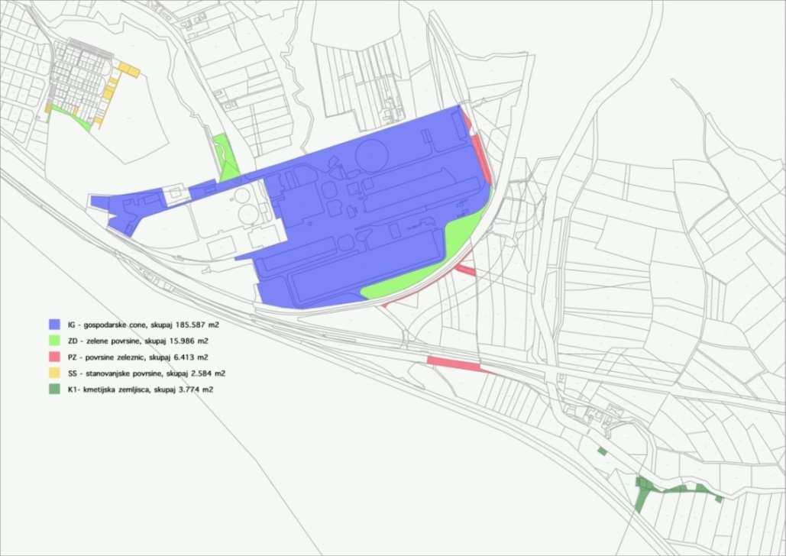
Extending to nearby
In particular, we would like to expose the possibility of extending to nearby, where, according to the spatial plan OPN, the envisaged economic zone.

Slide 9
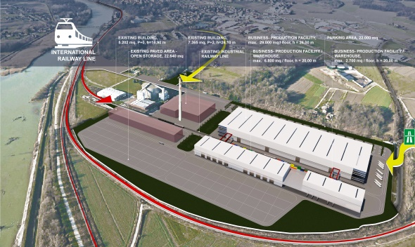
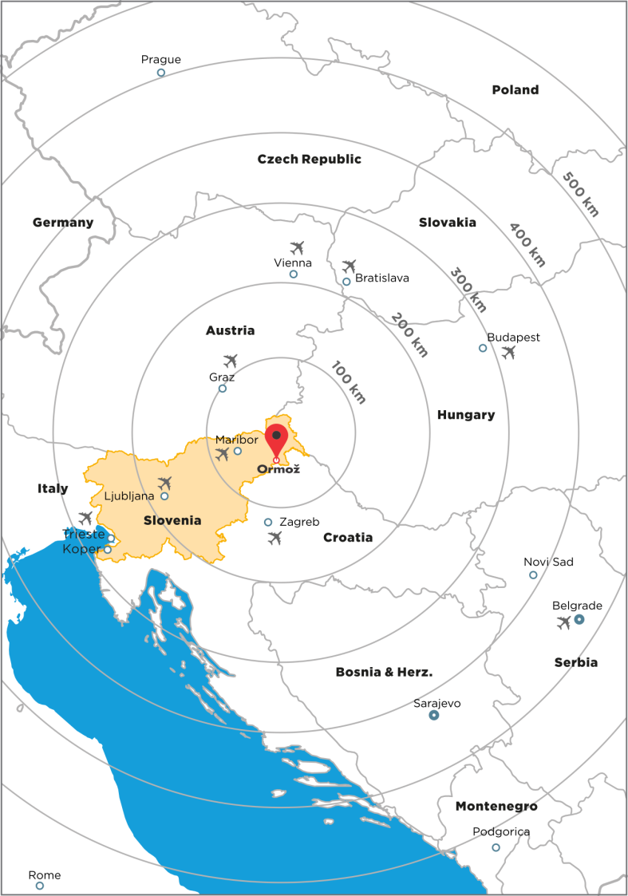
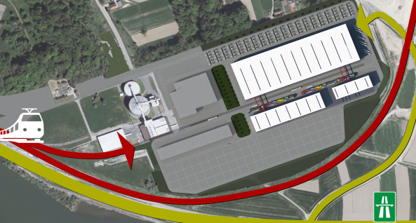
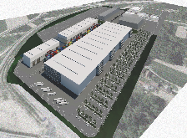

Slide 10
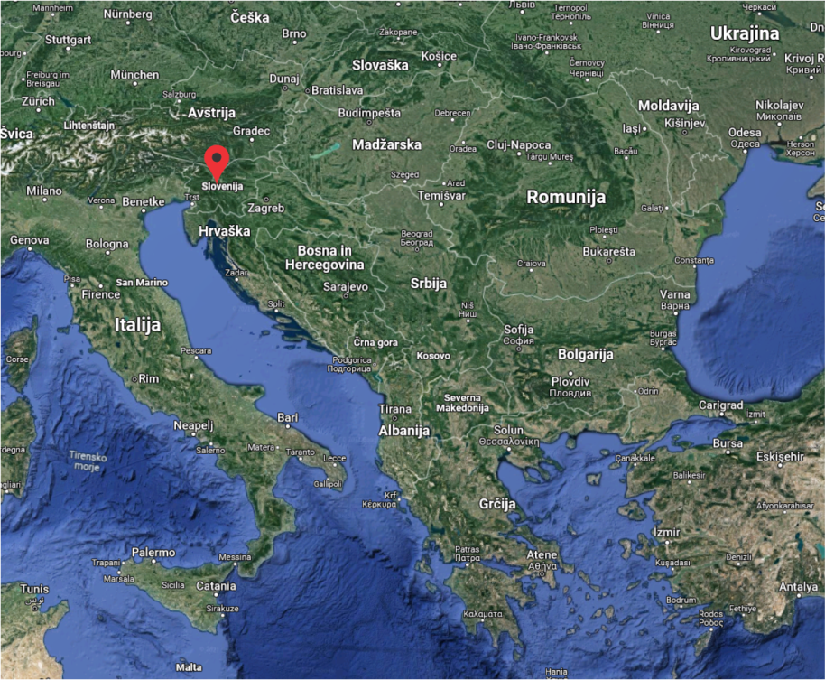
UNIQUE MIXED PROJECT AQUASAVA, Kranj

Slide 11
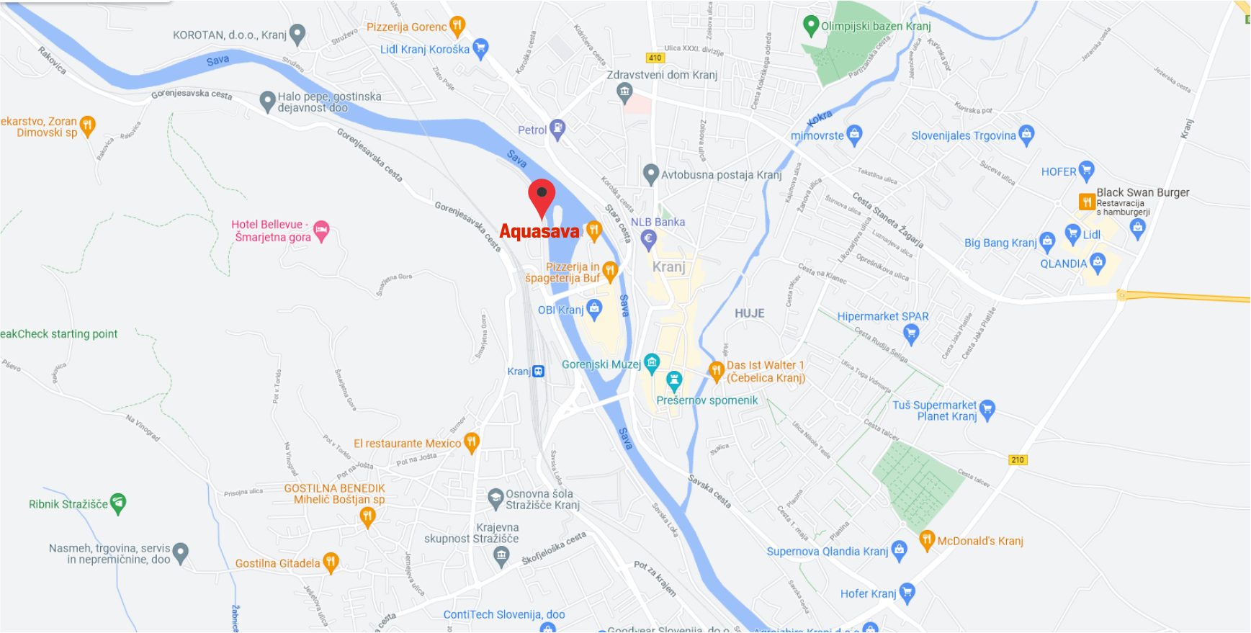
Micro location

Slide 12
Characteristics of the utility existing equipment
Available surface: 9 ha
Access roads
Connections to water resources
  Drinking water from the city water network DN 80
Connection to the gas network
  Dimension of the inlet pipeline: DN 40
Connection to the electrical network
  Connection power max. 5,6 MW

Slide 13
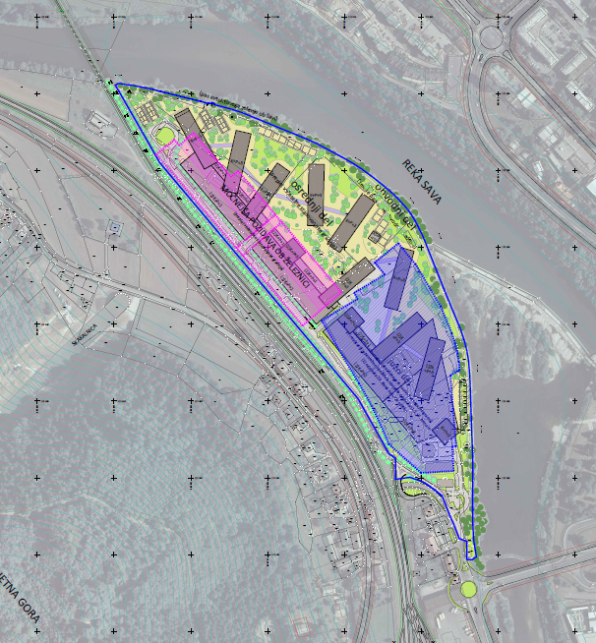
Urban plan OPPN
The spatial solution is emphatically related to both the main neighboring areas, both the course of the railway and the river.
It is divided into new program:
intensive southern part of the area with major construction and facilities of emphasized cultural, entertainment, and possibly hotel accommodation program
longitudinal course of stronger construction along the course of the railway, where the programs in the facilities are intended for garaging, logistics and trade facilities, and partly also for business activities

Slide 14
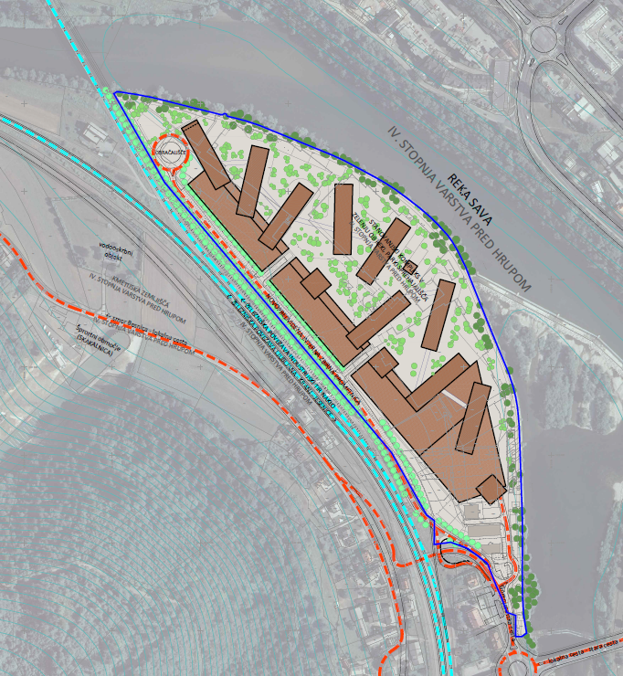
the central part, as an interweaving of multi-storey residential buildings in intensive greenery, which in the direction of the east passes to,
green park bypass arrangements for semi-public and public programs ending along the river as
a belt of autochthonous greenery along the Sava watercourse and
incoming communication in the south, which continues along the western part of the whole area.

Slide 15
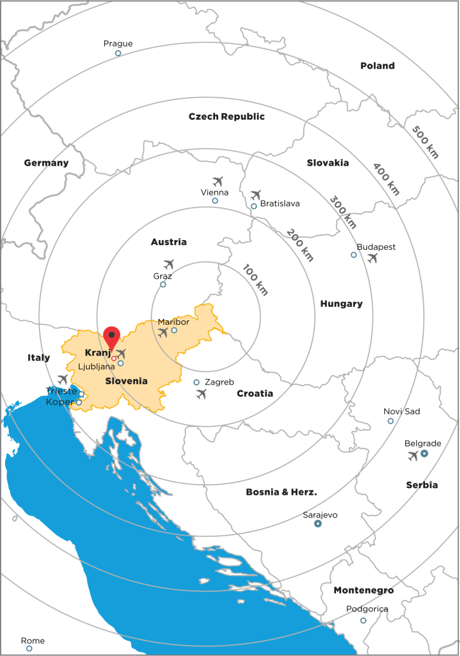

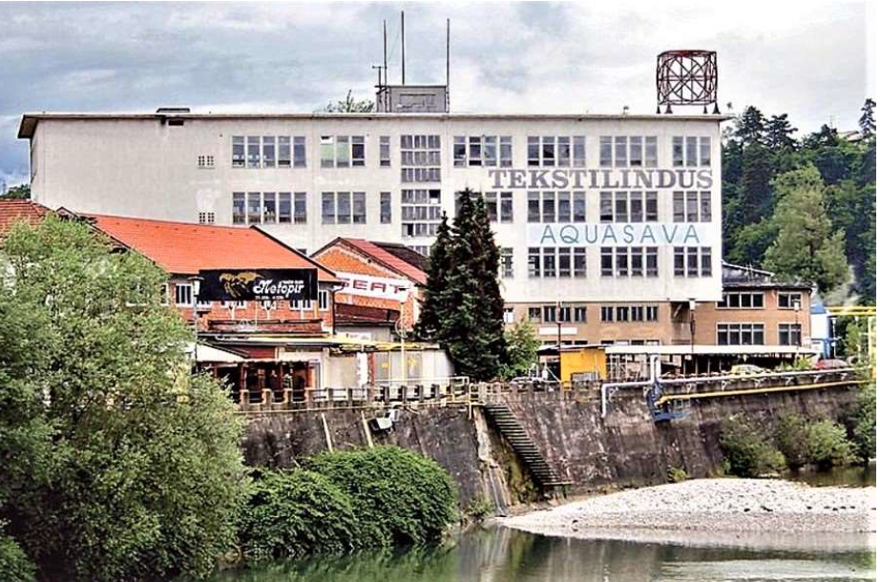
ABC REAL ESTATE
Tivolska 48 - Eurocenter, SI-1000 Ljubljana
Boštjan Blatnik
Mobile: +386 40 870 000
E-mail: bostjan.blatnik@abc.si

