Slide 2
ABOUT US
We are a business consulting and training company in the areas of quality, business processes, creative problem-solving, and innovation.
We have developed IT support for your operation for a modern way of management, a DNA app.

Slide 3
DNA allows you to run your business better. You develop your genome with the app.
It connects knowledge, organisation of the company, and operational management.

Slide 4
HISTORY
The NETS company has more than 30 years of experience based on a process approach, total quality management and management systems.
We help find effective solutions in the company's operations.
In the context of consulting, we find the company’s sustainable efficiency, developed according to the EFQM model, important.

Slide 5
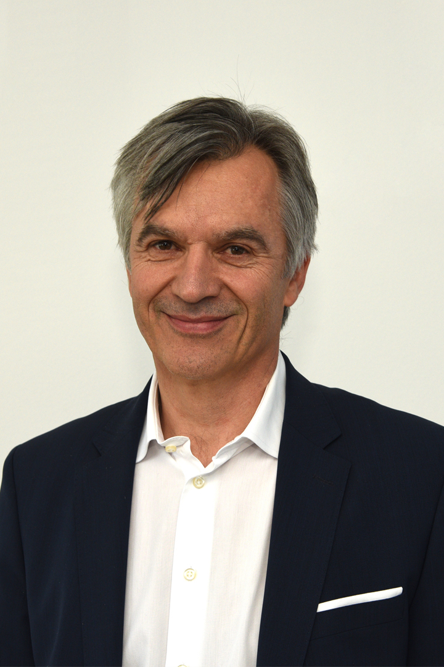
UROŠ GUNČAR
Director of NETS, d.o.o.
He is the only person in Slovenia to hold a licence for counselling and training according to the EFQM model.
NETS is a partner of EFQM.

Slide 6
REFERENCES

Slide 7
REFERENCES

Slide 8
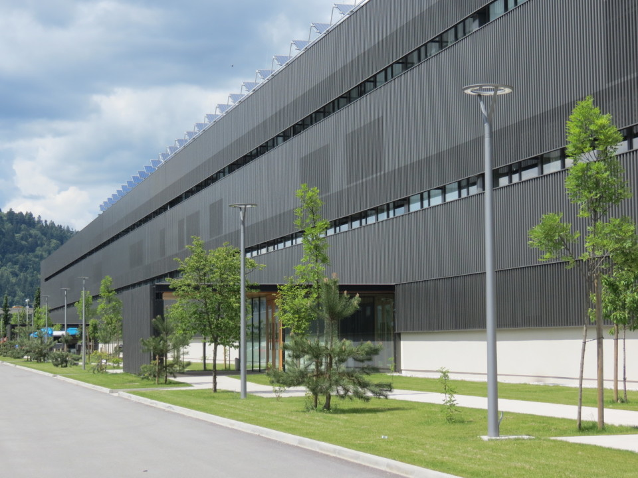
CONTACT
Ljubljanska cesta 24a
4000 Kranj, Slovenija
solutions@nets.si
+386 (0)41 672 032

